Slide 1
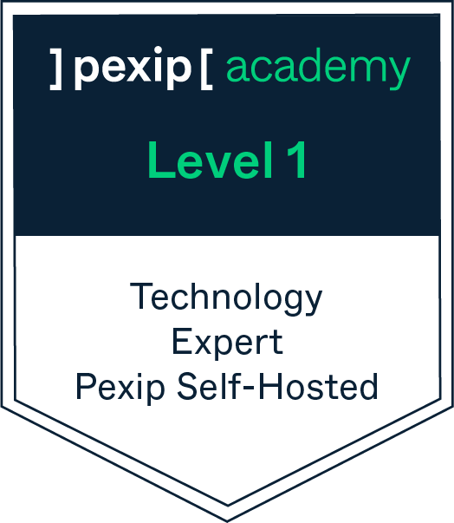

Pexip Infinity CTE
Self paced e-learning
Duration – 5 hours

Slide 2


CTE Level 1 Technical Training
Course outline
Theoretical technical overview of Implementing Pexip Infinity
Course objectives
Identify and relate Core AV and Networking technologies within the fundamentals requirements of a Pexip Infinity deployment.
Identify and define system architecture requirements for a Pexip self-hosted Infinity deployment.
Locate and identify technical documentation on docs.pexip.com to support the planning and installation of a Pexip self-hosted Infinity deployment.
Who should attend?
Video Support Engineers
Sales Engineers/Solution Architects
Video Systems Engineers
Video System Administrators
Channel Partners / Resellers
Next Steps
On successful completion of this course the learner will be able to:
Proceed onto the CTE Level 2

Slide 3


CTE Level 1 Technical Training
Prerequisites
Cisco CCNA level / Microsoft MCSE
What’s in the box?
The Certified Technology Expert Level 1 is self-paced theoretical training delivered in a series of e-learning video modules and assessments.
Working at your own pace, you will gain an insight into applying core technical principles to planning, deploying and configuring a Pexip Infinity platform, with an high-level overview of integrating Infinity with other networked systems. The Level 1 is mandatory for those looking to support / sell Pexip Self hosted Infinity Solution. Level 1 is designed to prepare you for the practical live lab tasks which form part of the CTE Level 2.
This is a technical course and we expect users to have a high level of IT experience and to be familiar with:
Video Conferencing /Collaboration systems and solutions.
IP networks /Firewalls /DNS /Certificates /Servers & Virtualisation /SIP H.323 protocols /RegEx.
VMware vCentre / ESXi hypervisor.
Microsoft Windows Server / Active Directory (LDAP), AD Certificate Services, SfB & MS Teams.
Microsoft Azure and Google Cloud service platforms.
Remote administration of systems is via RDP and SSH terminals.

Slide 4


Program overview
Watch then test
Modules
To be taken first AV Networking Assessment | 3 part baseline assessment module. (17 mins) Self Assessment (2 mins) General IT Networking warm-up – (5 mins) Scenario time. (10 mins)
Pexip Infinity: The Fundamentals | 3 part module. (9 mins) A distributed enterprise application Examples of a deployment Distributed Architecture Assessment – 5 minutes
Planning a basic installation of Pexip Infinity | 10 part module (51 mins) Planning an installation of Pexip Infinity Installing the Management node in a VMware environment Completing the Management node install wizard Configuring System settings Further Management node configuration Configuring System locations Creating a Conferencing node Deploying a conferencing node in VMware Completing the deployment of a conferencing node Additional Conferencing node configuration 10 x Assessments – 50 minutes

Slide 5
Program overview
Watch then test
Modules
How to use the Pexip Infinity Technical Documentation site. | 1 part module (8 mins) An introduction to docs.pexip.com
Regex Fundamentals | 2 part module (9 mins) A basic introduction to Regular Expression RegEx within Infinity Assessment – 5 minutes
SIP Signalling Fundamentals | 1 part module (14 mins) A basic introduction to SIP Signalling Fundamentals Assessment – 5 minutes
DNS within Infinity | 1 part module (14 mins) DNS within Infinity Assessment – 5 minutes
Networking | 1 part module (16 minis) Networking fundamentals for an Infinity deployment Assessment – 5 minutes

Slide 6
Program overview
Watch then test
Modules
TLS Certificate Fundamentals for Infinity | 2 part module (20 mins) Intro to Certificates Certificates within Infinity Assessment – 5 minutes
Data Traffic Flow and Firewall Configuration Fundamentals for Infinity | 2 part module (20 mins) Basic Firewall Configuration Data Traffic and Protocol Flows Assessment – 5 minutes
Virtulisation & Server Design | 3 part module (25 mins) Intro to Virtulisation & Server Design Resource allocation & Server Design NUMA Pinning and Vmware Assessment – 5 minutes

